Slide 1
2021 Richard Liebendorfer, MD Ethics Symposium: Women’s Health is Human Health
Monday, October 4, 2021
Presented by the Ascension St. John Ethics Integration Committee
Notes:
To select a different photo title/cover slide please right click on the slide, then select Apply Layout where you can select from additional choices

Slide 2
First, you must pair your mobile phone to your account in CloudCME®. Text your Ascension email address to (855) 941-2118, then text the Activity ID to the same number.
10/04/2021 Activity ID
2966
Having Difficulty?
Visit https://ascension-ce-cme.cloud-cme.com
to update your profile

Slide 3
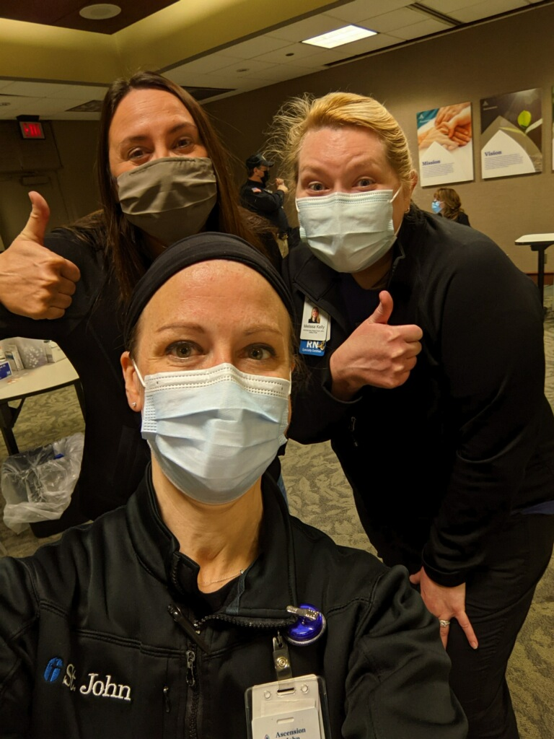
AGENDA
5:00 p.m. Welcome
5:05 p.m. Reflection and Prayer
5:15 p.m. Poverty Formation Experience
6:00 p.m. Keynote: Breaking the Societal Perception of Plastic
Surgery
6:30 p.m. Fertility Awareness Based Medicine
7:00 p.m. The 2021 Dr. H. William Allred Excellence in Ethics Award
7:10 p.m. Break
7:20 p.m. Women as Health Care Decision-Makers:
Panel Discussion
8:10 p.m Closing Remarks
Liz Bell, Missy Kelly and Morgan Beyerl run the ASJ COVID
vaccine clinic

Slide 4
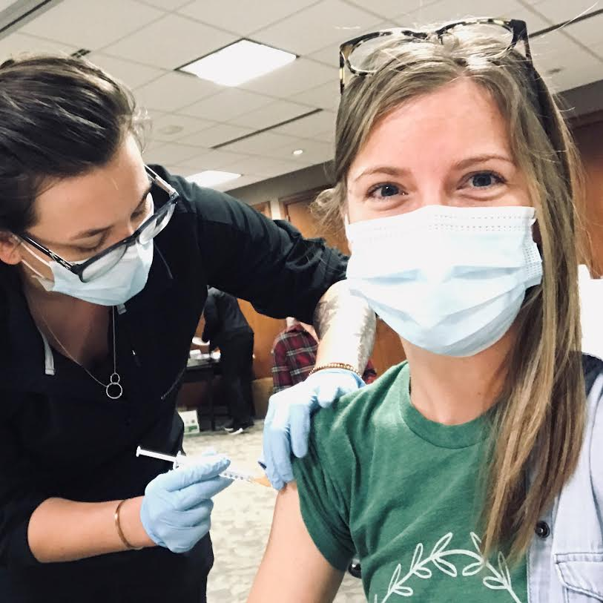
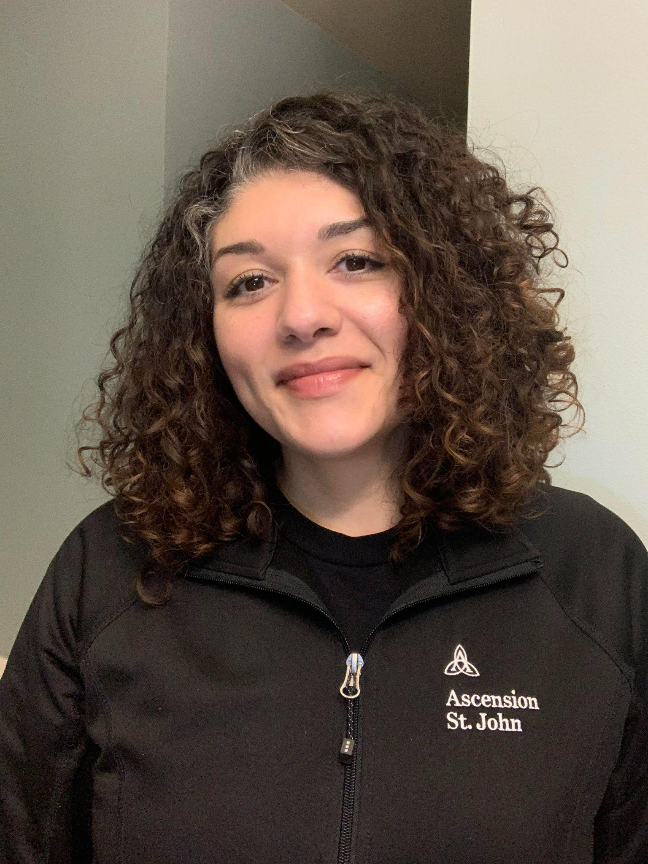
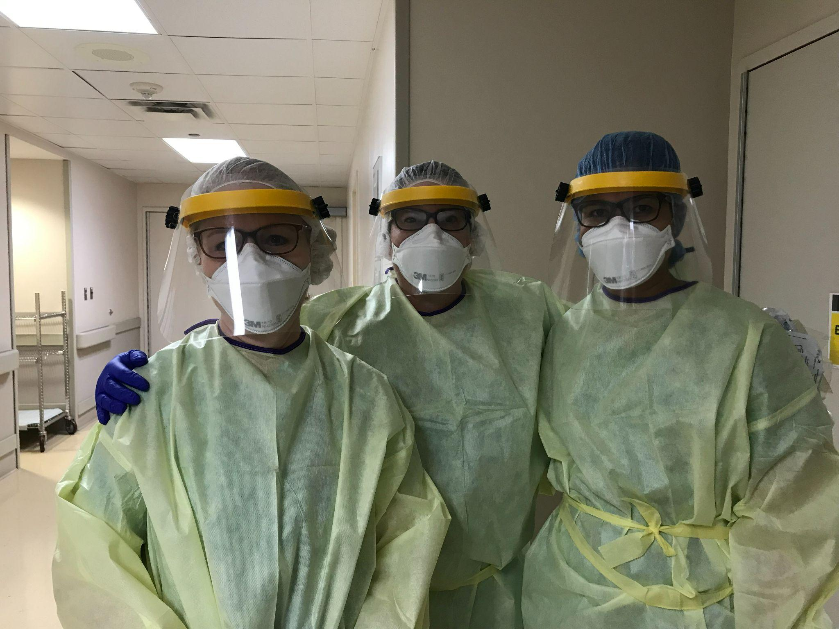
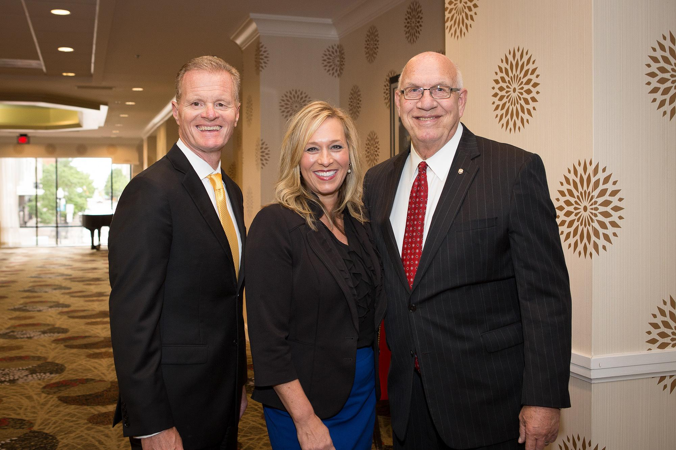
2021 Liebendorfer Virtual Ethics Symposium
The content presented and resources referenced during this event are provided by the presenters as individual professionals and do not necessarily reflect the positions of Ascension, its ministries, or its subsidiaries.

Slide 5
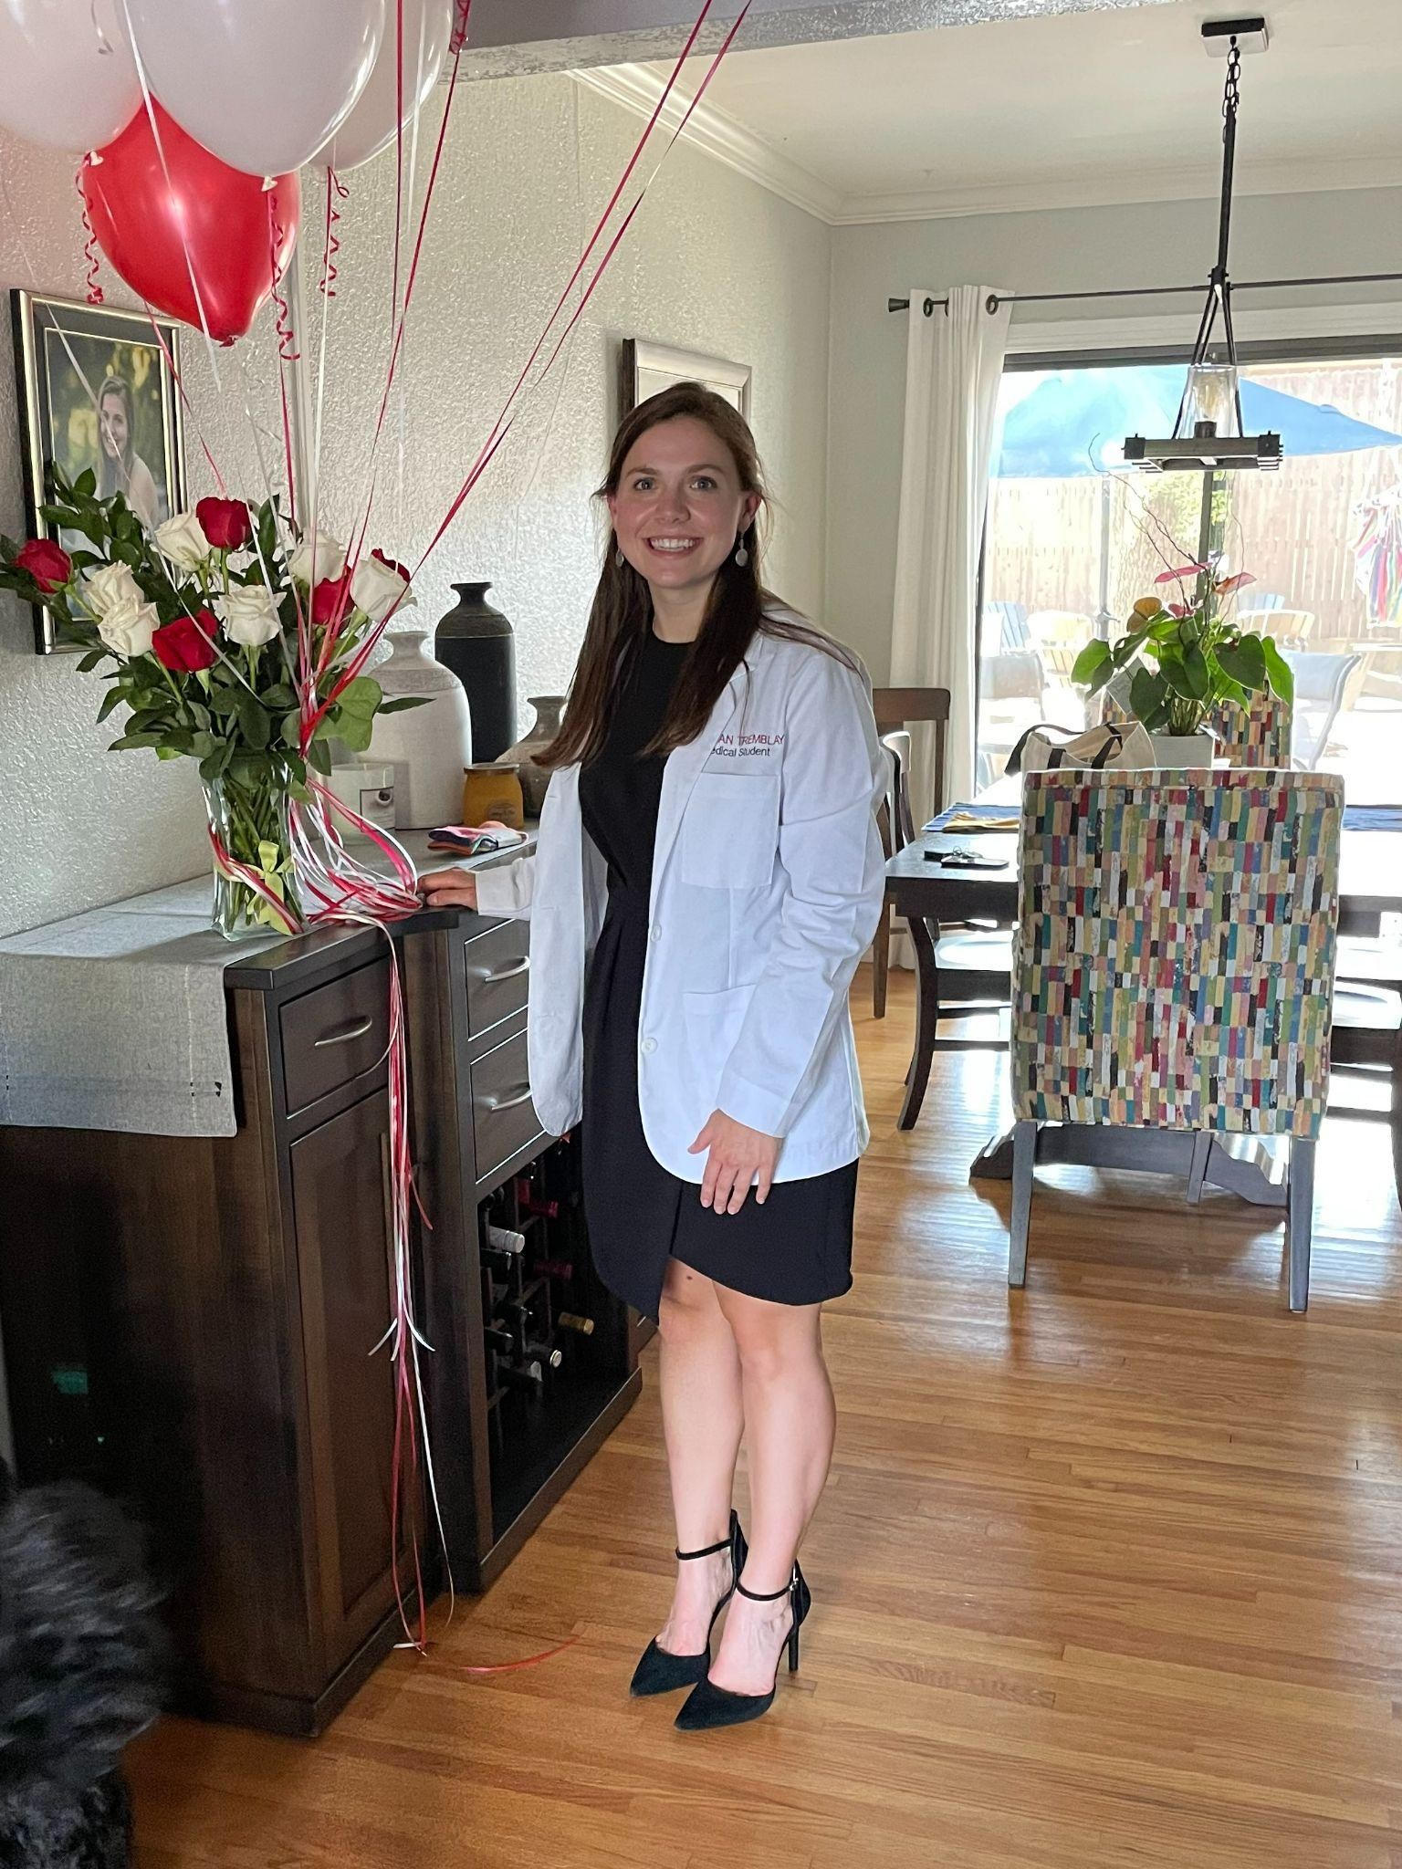
Opening Prayer
Ron Tremblay, BCC, LPC
VP, Chief Mission Integration Officer
Raegan Tremblay, future physician, celebrates her White Coat ceremony Fall 2021

Slide 6
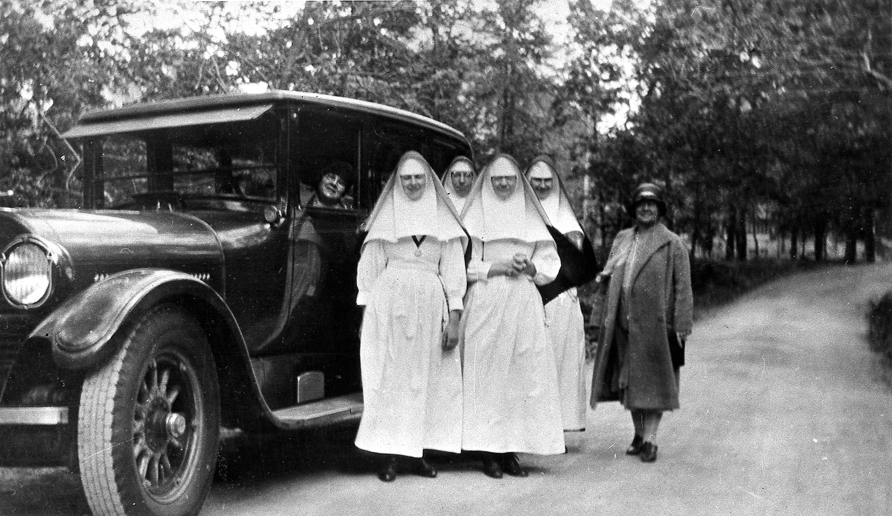
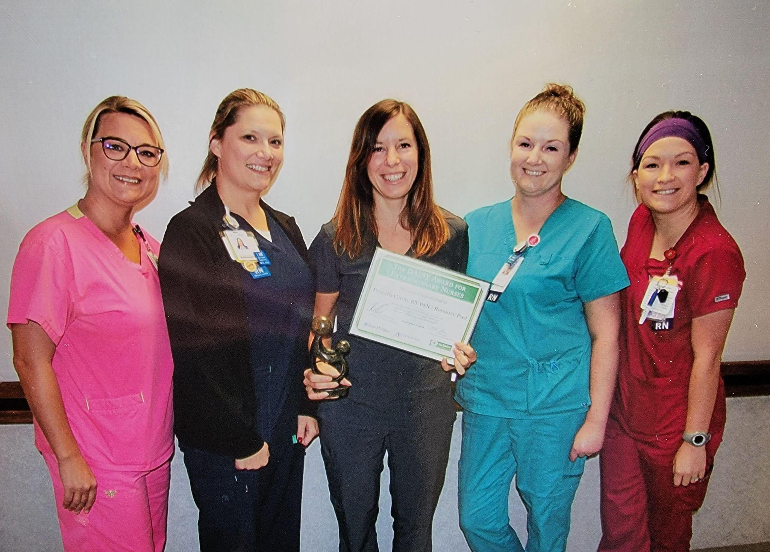
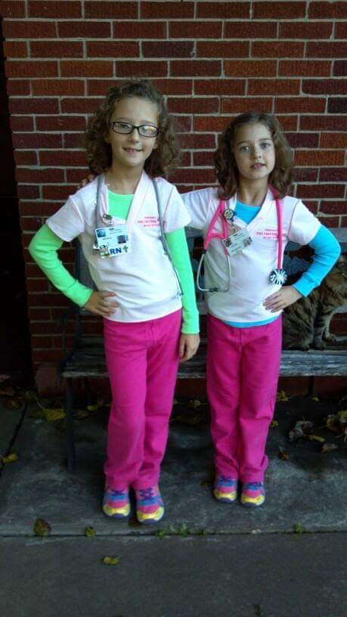
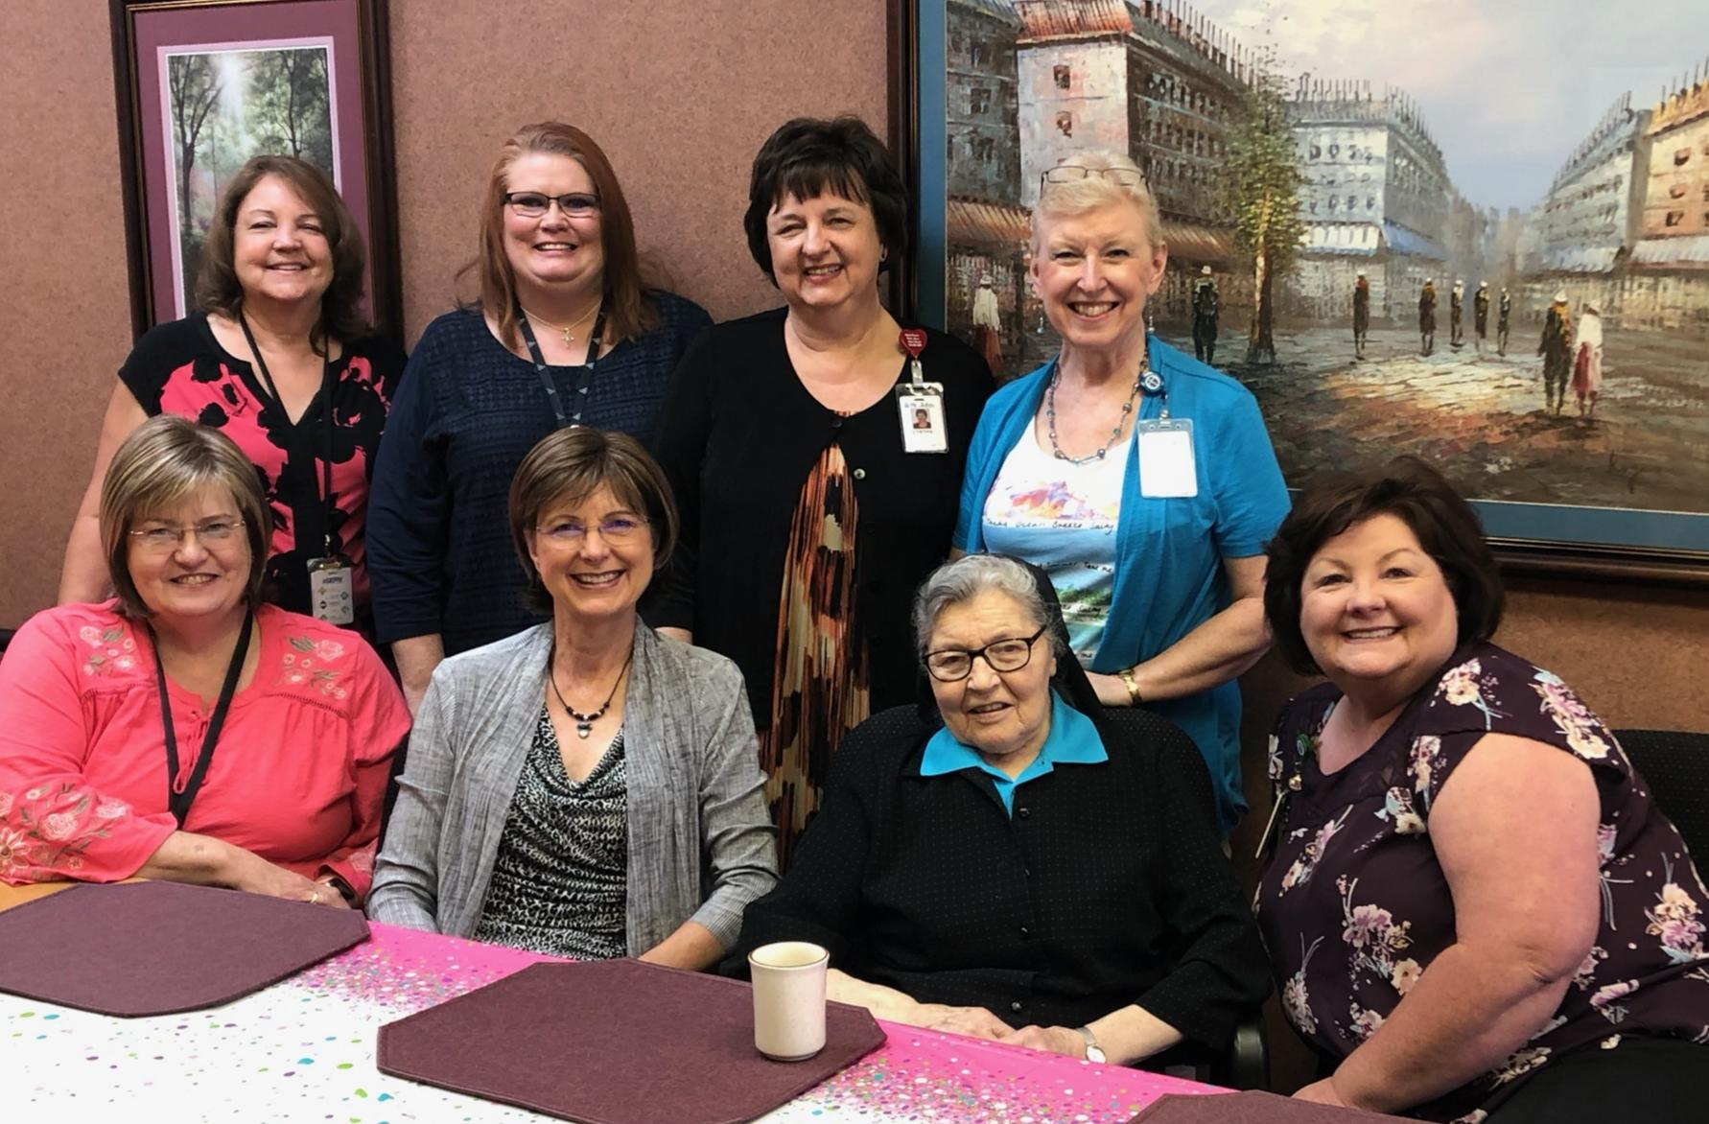
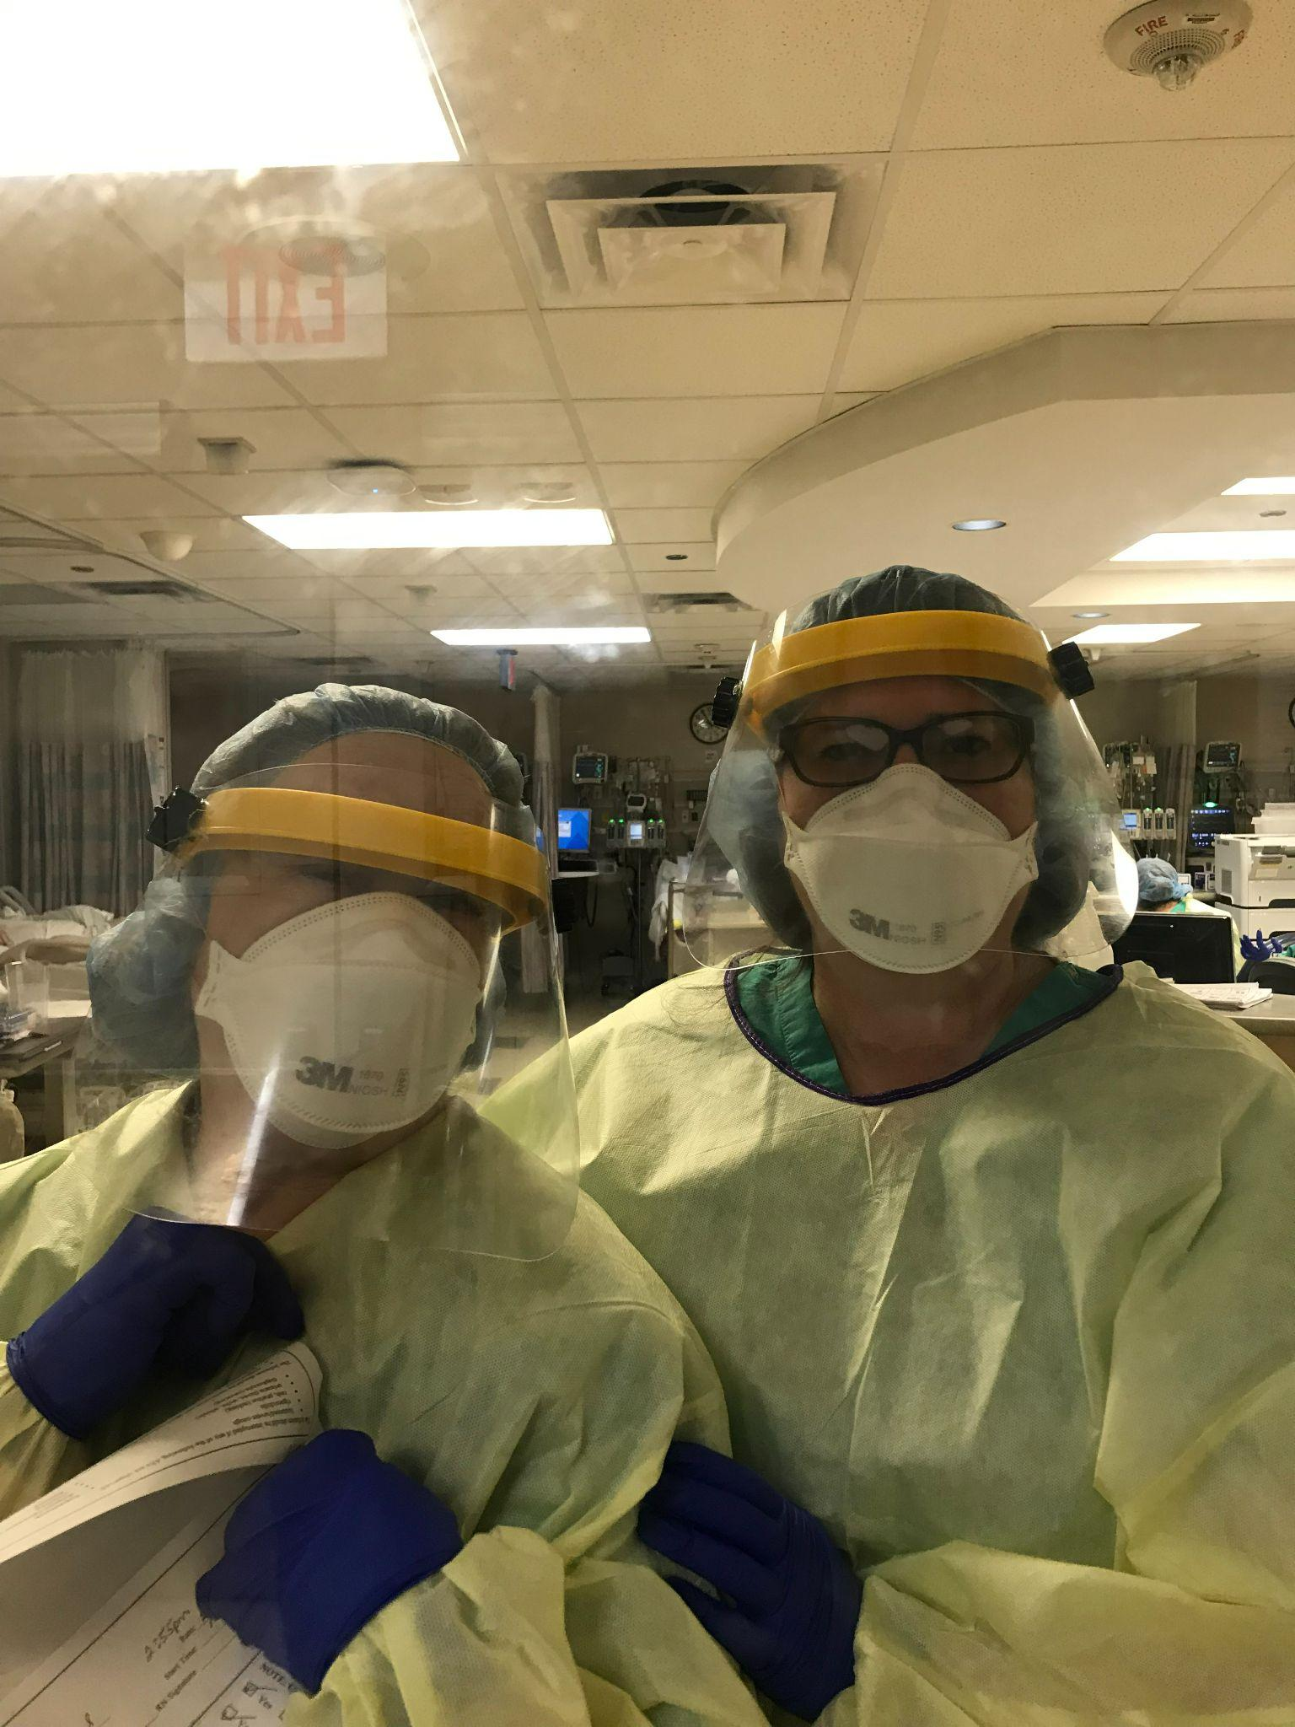

Slide 7
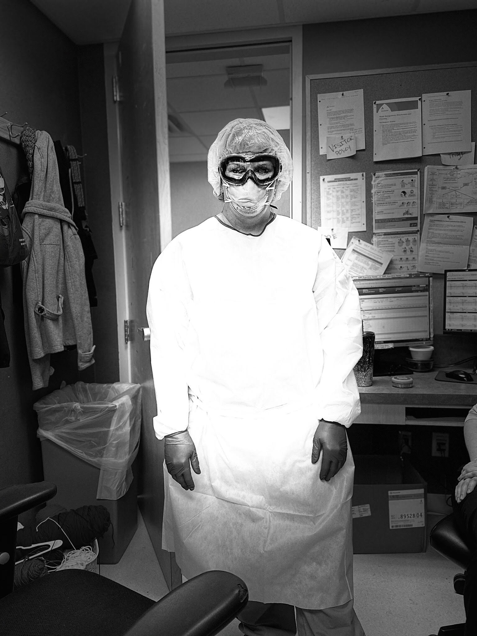
2021 Liebendorfer Virtual Ethics Symposium
Please remember to remain muted when not speaking
If you would like to participate in the Q&As, please type your questions in the chat box
If you experience technical difficulties, please use the chat and direct your message to the panelists
A nurse on the Maternal-Child floor dressed in her COVID PPE

Slide 8
Case Study
Mary Kay McVey and Stephanie Farris
Notes:
Link to tabletop discussion: https://docs.google.com/document/d/11GK27AJ81nVHelogsrOs7rAxg6w5NKFhAPrf8EqqXAU/edit?usp=sharing
45 minutes
October 4 - 5 to 8:15 p.m. (first presentation, at approximately 5:15 p.m.)

Slide 9
Case Study
Ethical And Religious Directive #3
In accord with its mission, Catholic health care should distinguish itself by service to and advocacy for those people whose social condition puts them at the margins of our society and makes them particularly vulnerable to discrimination: the poor; the uninsured and the underinsured; children and the unborn; single parents; the elderly; those with incurable diseases and chemical dependencies; racial minorities; immigrants and refugees. In particular, the person with mental or physical disabilities, regardless of the cause or severity, must be treated as a unique person of incomparable worth, with the same right to life and to adequate health care as all other persons.
Notes:
6th edition of the Ethical and Religious Directives - Directive 3
states that as a ministry of the Church, Ascension St. John is called to distinguish itself through service to and advocacy for those who are vulnerable.
This mandate is reflected in the Ascension Strategic Plan’s North Star - placing the poor and vulnerable at the center of all our work.
Monica Barczack, Director of Indigent Healthcare Funding at Ascension St. John will walk us through a case scenario to further explore this concept.

Slide 10
Perspective 1: You are working in the ER when John, a 63 year-old male arrives in respiratory distress
Case Study
John visits the ER frequently with this condition.
Has not taken the asthma medication prescribed during the last ER visit or filled the prescription.
John didn’t attend the follow-up appointment scheduled with his primary care physician.
He suffers from early stages of dementia.
John is accompanied by his daughter and caregiver, Julie.
He lives with Julie and her children.
John’s health proxy, named in the advance directive, is an adult son who lives in California.
Notes:
You are an emergency room provider.

Slide 11
Case Study
Questions:
How do you feel about John’s non-compliance with his care plan?
Do you contact Adult Protective Services?

Slide 12
Perspective 2: You are Julie, the caretaker
Case Study
42-year old daughter of John and his primary caregiver
Single mother of three children who are five, seven and 15 years.
You live with your children and father in an apartment.
You are afraid to walk in your neighborhood.
You do not have a car.
You must take two buses to reach the hospital.
The primary care physician’s office is not on a bus route.
You work two part-time jobs.
Your gross pay is approximately $3,000 per month, above eligibility for Medicare.
Notes:
We are going to work through a case study to explore the principle of Solidarity further.
Invite participants to Journal - 60-90 seconds. Share some thoughts in the chat box.

Slide 13
Case Study
Questions:
How do you experience John’s ongoing health challenges?
What inhibits your ability to follow John’s care plan?

Slide 14
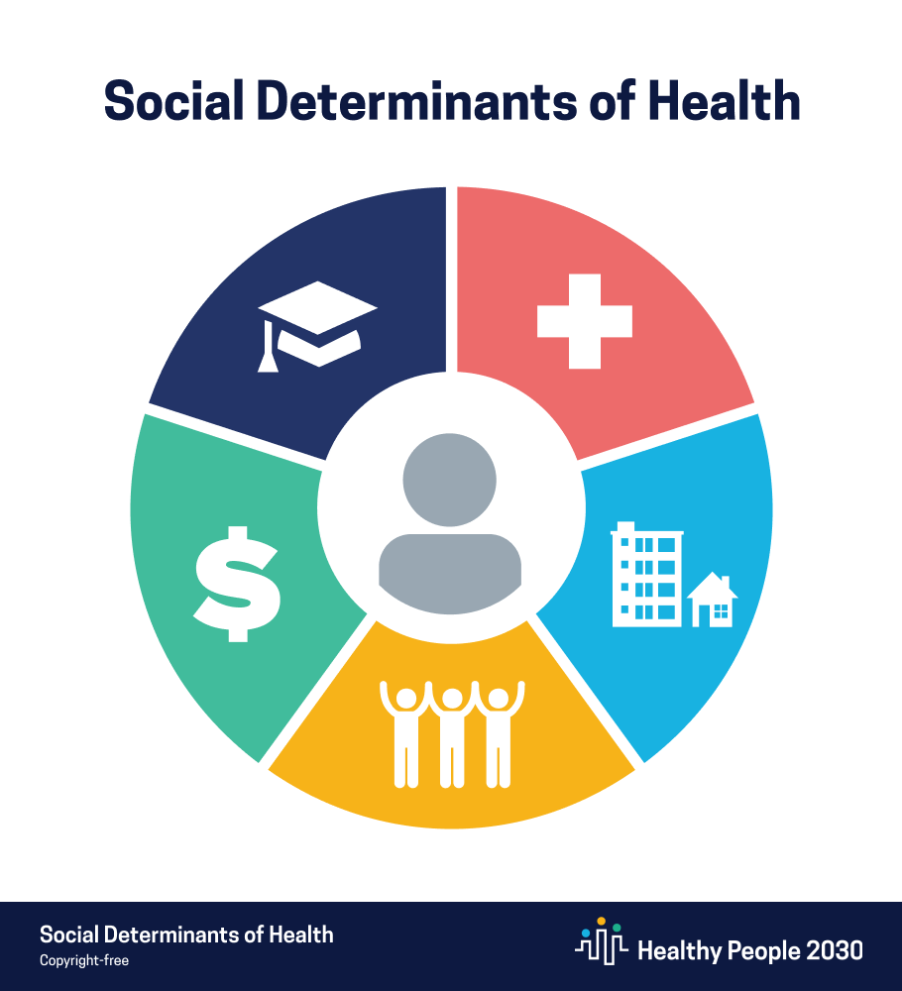
Social Determinants of Health
Examples:
Safe housing, transportation, and neighborhoods
Racism, discrimination, and violence
Education, job opportunities, and income
Access to nutritious foods and physical activity opportunities
Polluted air and water
Language and literacy skills
5 Domains
Economic stability
Education access and quality
Health care access and quality
Neighborhood and built environment
Social and community context
Notes:
Social determinants of health (SDOH) are the conditions in the environments where people are born, live, learn, work, play, worship, and age that affect a wide range of health, functioning, and quality-of-life outcomes and risks.

Slide 15
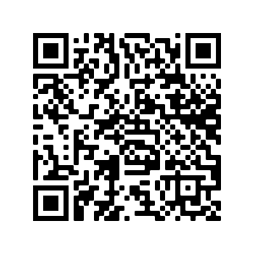
Breakout Room Discussion
Reflection
Select a facilitator and scribe.
Discuss the scenario questions.
Scribe: you will be invited to share your breakout group’s insights.
Notes:
NOTE: add link to tabletop content in the chat: https://docs.google.com/document/d/1dv3RgYScZFf8G1sK0uHOBGlflSB8UFOqETk5mI3VnZg/edit?usp=sharing

Slide 16
Questions for Breakout Rooms
Reflection
How did you feel when you read John’s case scenario? For example, were you inclined to call APS?
Did your feelings change after reading Julie’s challenges as John’s caregiver?
What ethical considerations come to mind?
What are the health care team’s responsibilities to John and Julie? When do they begin and end?
Is deeming the patient/caregiver non-compliant consistent with ERD 3 and Principle of Solidarity?
What do you recommend going forward?
Notes:
1. How did you feel about John when you read about his case scenario? How did you feel about Julie?
2. Were you inclined to call APS? What is the purpose of calling authorities- to help John or punish Julie?
3. Did your feelings change after reading Julie's challenges as John's caregiver?
4. Does Julie want to be John's caregiver, and does that matter? What about the son in California?
5. Is deeming the patient/caregiver non-compliant consistent with ERD 3 and Principle of Solidarity?
6. What are the health care team's responsibilities to John and Julie? When do they begin and end?
7. How can we 'meet Julie where she is at' while also improving John's health care outcomes?

Slide 17
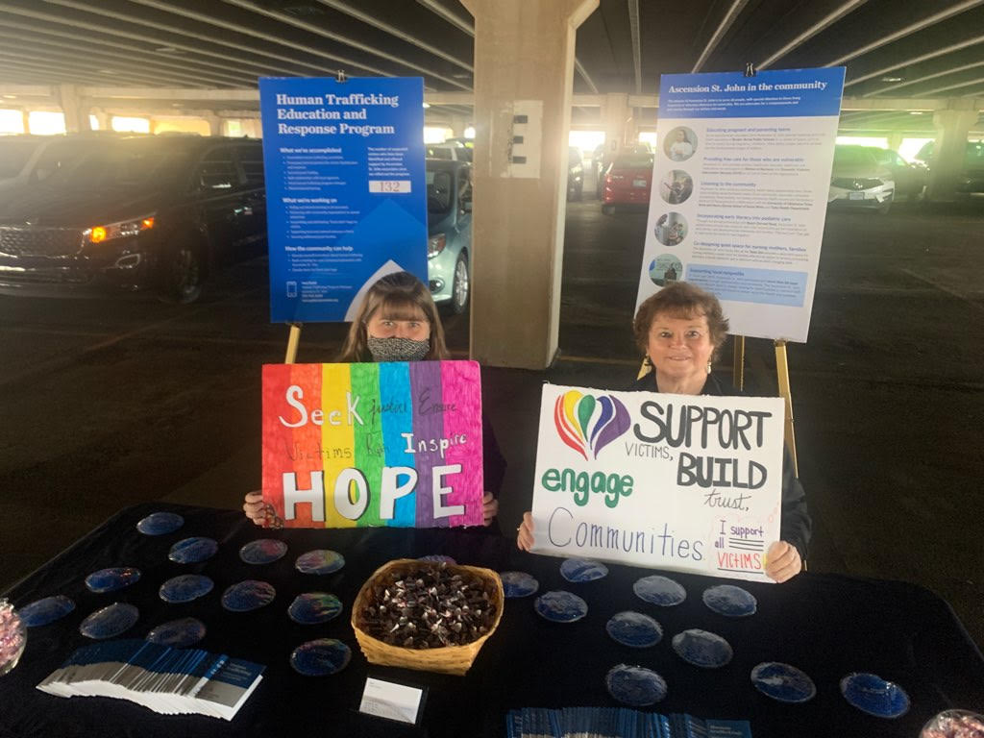
Brain Break
First, you must pair your mobile phone to your account in CloudCME®. Text your Ascension email address to (855) 941-2118, then text the Activity ID to the same number.
10/04/2021 Activity ID 2966
Having Difficulty?
Visit: https://ascension-ce-cme.cloud-cme.com to update your profile
Annie Smith, Sara Gadd, and LaQuita Jones promote Mission Integration’s Human Trafficking Education and Repsonse Program

Slide 18
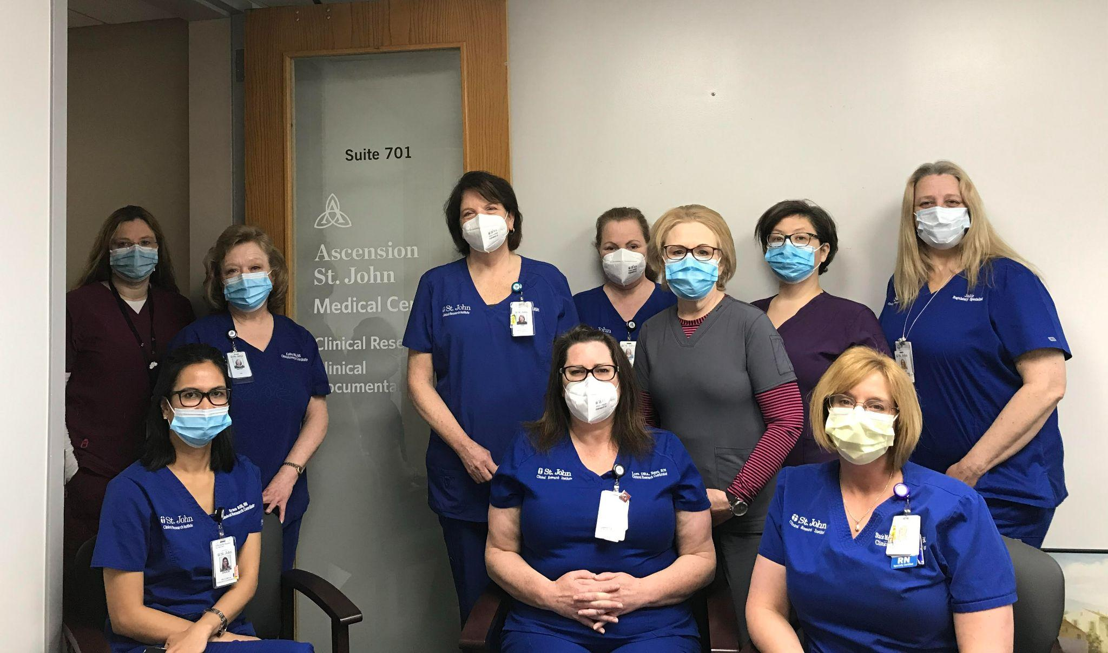
Dr. H. William Allred, MD
Excellence in Ethics Award
2021
Presented by Dr. John Hendrix, MD, FAAHPM, Chair of the ASJ Ethics Integration Committee
Exemplifies Catholic moral and ethical principles when working with patients, families and fellow staff.
Works to promote ethics awareness throughout the ministry.
Someone who others come to when they need guidance on the “right thing” to do.
Someone you have witnessed making a difficult decision because it was the most ethical course of action.
Holds themselves accountable for mistakes and continually seeks education and improvement.
ASJ Clinical Research department
Notes:
In 2019, the Ascension St. John Ethics Integration Committee instituted the Excellence in Ethics award in honor of Dr. H. William Allred’s many years of service in Medical Ethics. The award is given annually to recognize Excellence in Ethics within the award winners’ sphere of influence.
Nominees do not need to be a member of the Ethics Integration Committee. They may be any associate, employed or affiliated provider or community member currently serving on an Ascension St. John board or committee who is exceptional in the provision of reflective, proactive, integrative ethics.
This is a person who embodies the following criteria:
Exemplifies Catholic moral and ethical principles when working with patients, families and fellow staff.
Works to promote ethics awareness throughout the ministry.
Someone who others come to when they need guidance on the “right thing” to do.
Someone you have witnessed making a difficult decision because it was the most ethical course of action.
Holds themselves accountable for mistakes and continually seeks education and improvement.
This year, we had 33 nominations.
One of Kathy’s nominations:
Kathy is the person we all go to when we need to know the right thing to do. Talking with her, you just know that her position will be thoughtful, considered, kind, and ethical. She's willing to talk you through the most difficult ethical quandaries. Kathy speaks to each patient as a researcher, as a scientist, as a nurse, and as a Christian. In each role, she honors the patient's rights and choices. Kathy invites us all to Ethics Brown Bag lunches, sends us articles and information on ethics, and is our role model for ethical behavior. She acknowledges her flaws as a human being and will be the first to tell you if she made a mistake. Kathy takes it upon herself to do one of the most difficult parts of our job: to be the unblinded pharmacist that dispenses the study drug or the placebo. She's the only one who knows what each patient receives in those studies. It's hard to be the person to dispense a placebo to someone who might benefit from getting the drug. It's also one of the most challenging positions to be in, to keep everyone else, even your coworkers in the dark about the study assignment and carry that burden alone. But she does it without hesitation but her ethical convictions are strong. She never takes the easy way out, because that would compromise the safety of the patient, the integrity of the study, and her personal convictions. I admire Kathy's ethical positions very much.

Slide 19
Kathryn Mears, MS, RN
RN Clinical Research Coordinator
Clinical Research Center
2021 Allred Excellence in Ethics Award Winner

Slide 20
Breaking the Societal Perception of Plastic Surgery
Dr. Lesley Landis, MD, FACS
AMG Plastic Surgery

Slide 21
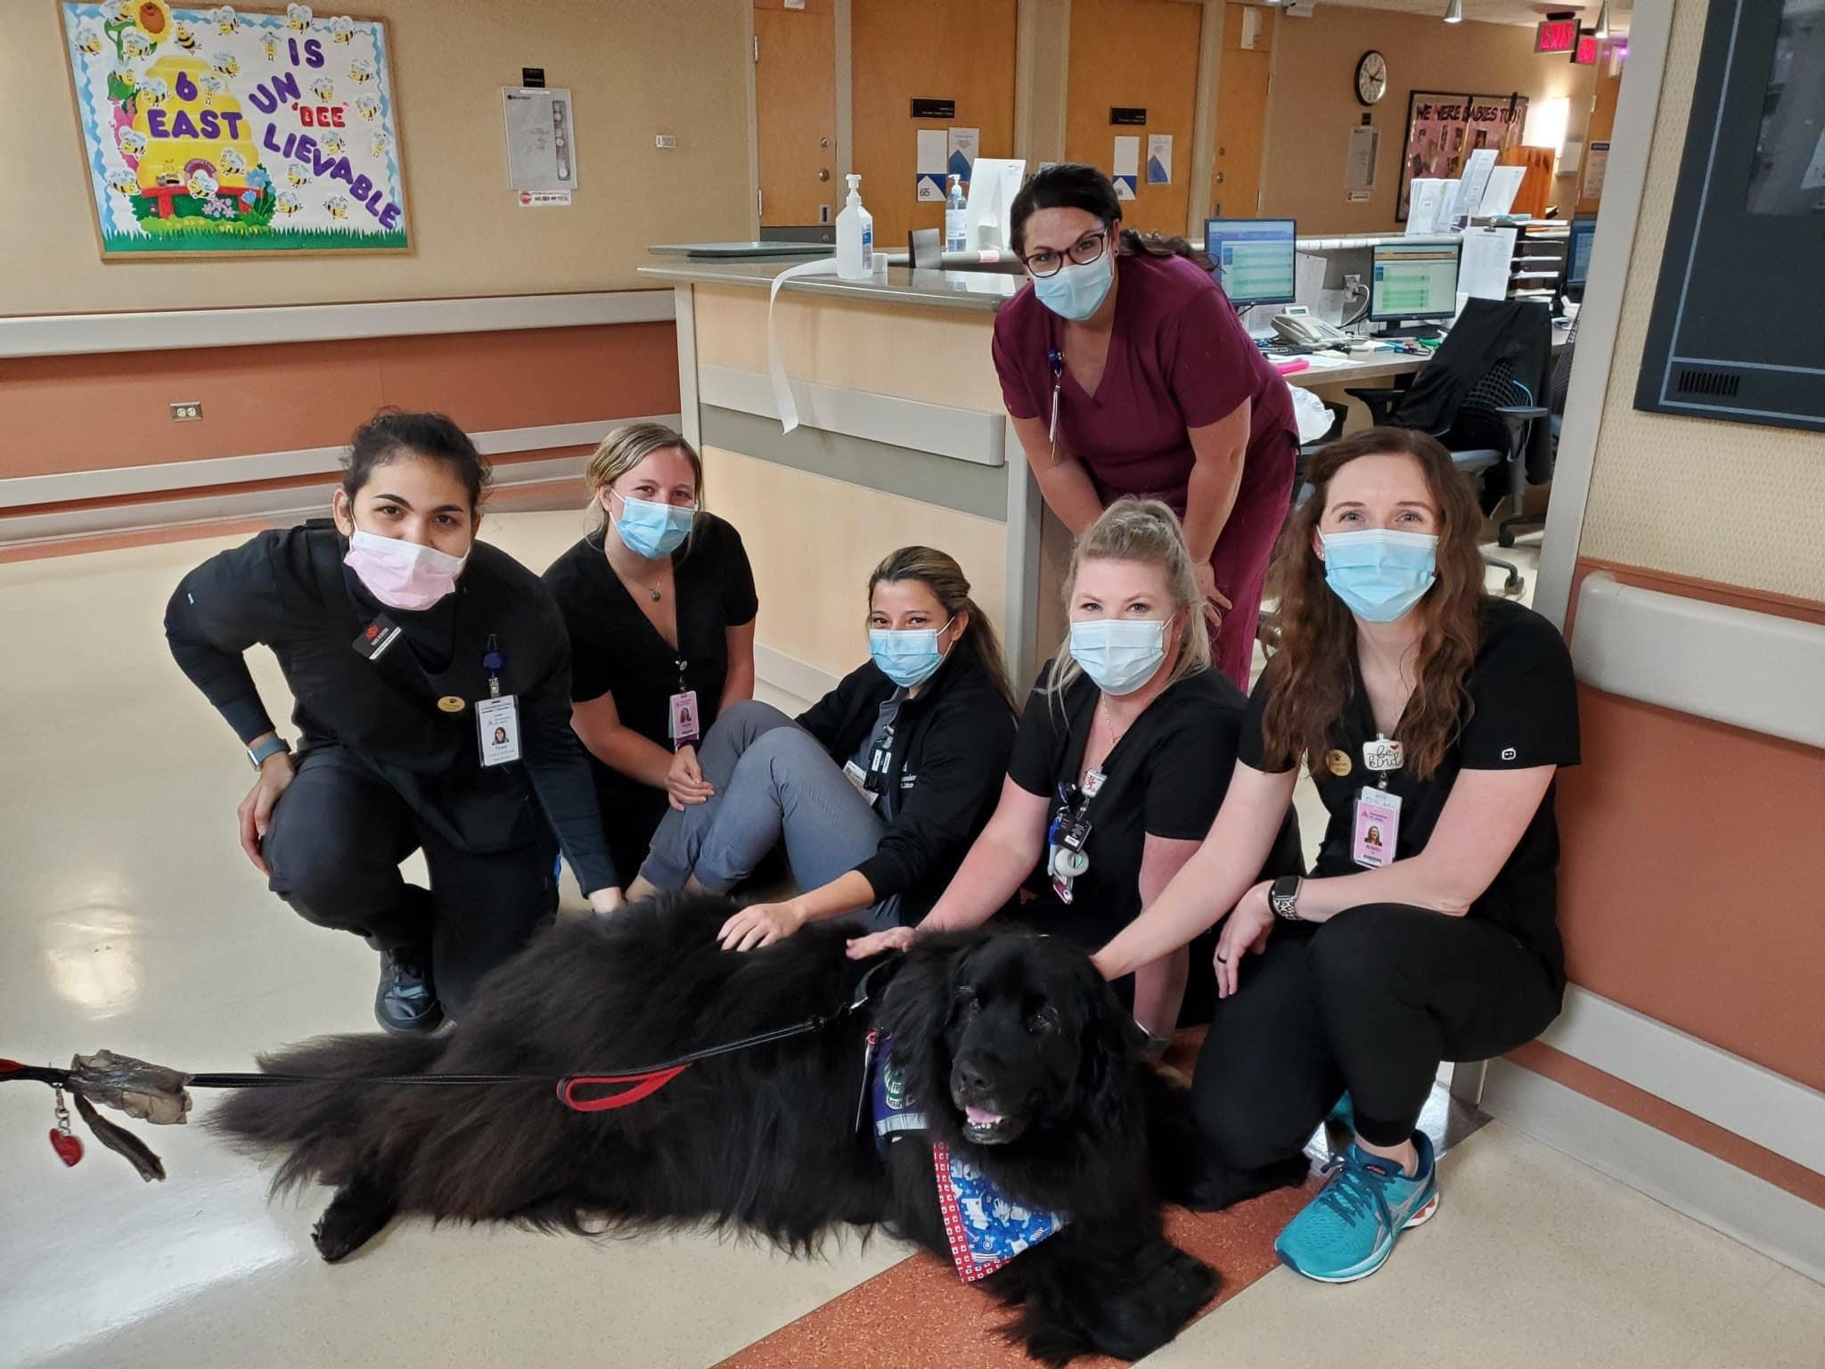
Women as Healthcare Decision- Makers: Panel Discussion
Moderated by:
Audrey Corbett, MD, FACP
Featuring:
Latonya Mason-Wilson, MS, RN, NE-BC
Mindi Henry, APRN-CNP, ACHPN
Liz Bell, MHA, BSN, RN
Audrey Harris, DO
Nurses from 6E unwind with some pet therapy

Slide 22
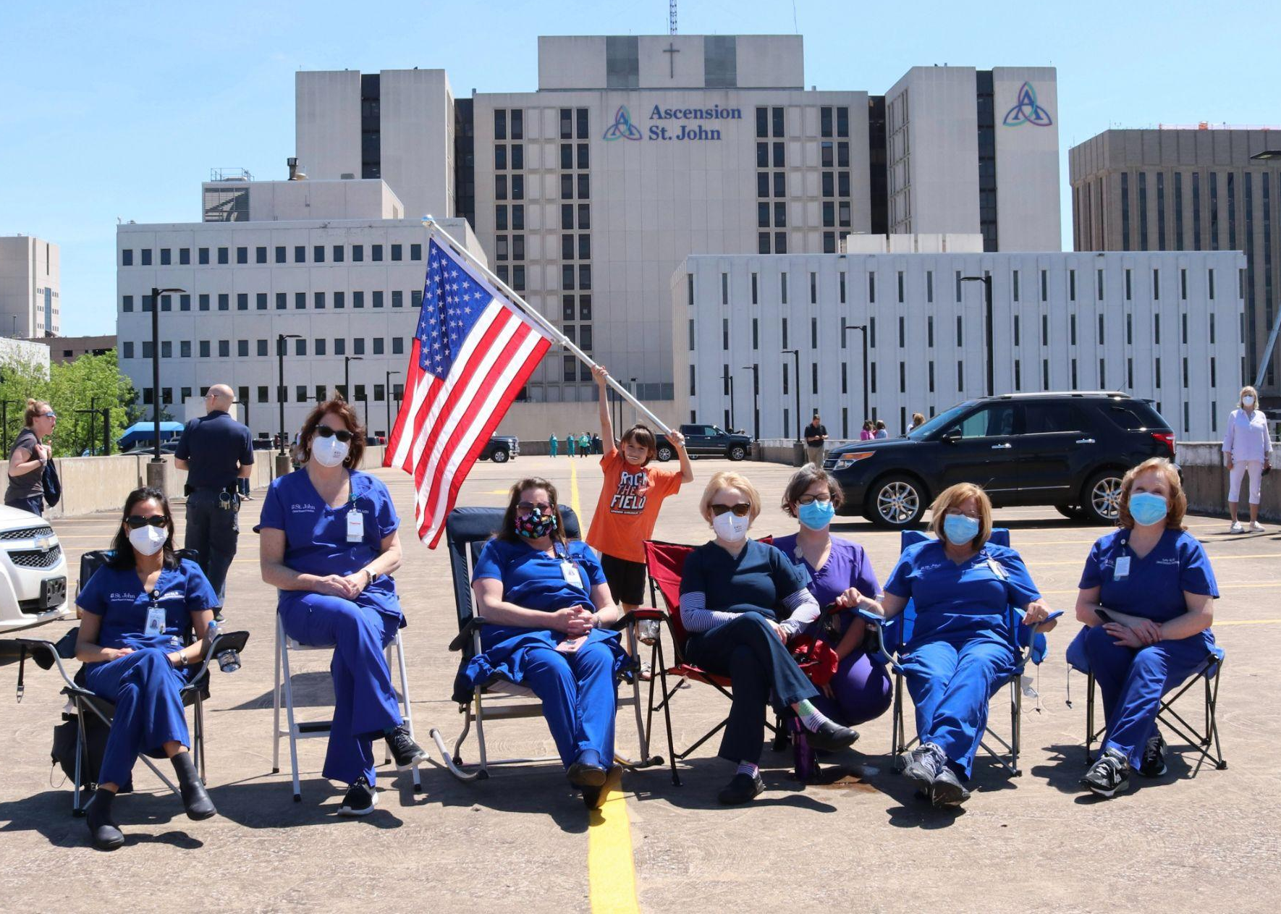
Women as Healthcare Decision- Makers: Panel Discussion
Topics:
Barriers to Recognition and Access to Women’s Health
Ethical Dilemmas for Women in Leadership
Fairness and Equity in Pandemic-Related Women’s Issues in the Workforce

Slide 23
Bossy
A little less vocal
Watch your tone
Quiet your voice

Slide 24
3 million women have left the workforce¹
And many don’t plan to come back…
1 in 3 women are considering leaving or changing jobs²
https://www.npr.org/2021/06/03/1002402802/there-are-complex-forces-keeping-women-from-coming-back-to-work
https://www.cnbc.com/2021/09/27/1-in-3-women-are-considering-leaving-the-workforce-or-changing-jobs.html

Slide 25
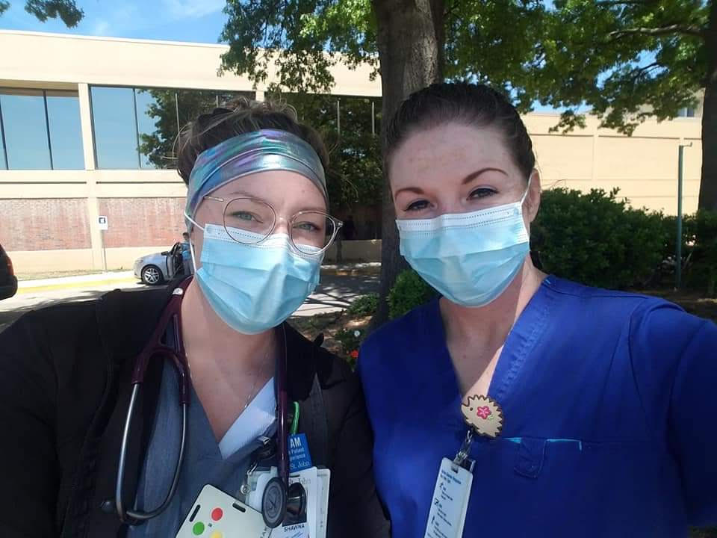
2021 Liebendorfer Virtual Ethics Symposium
3 Million women have left the workforce¹ and many do not plan to come back
1 in 3 women are considering leaving or changing jobs²
1.https://www.npr.org/2021/06/03/1002402802/there-are-complex-forces-keeping-women-from-coming-back-to-work
2.https://www.cnbc.com/2021/09/27/1-in-3-women-are-considering-leaving-the-workforce-or-changing-jobs.html

Slide 26
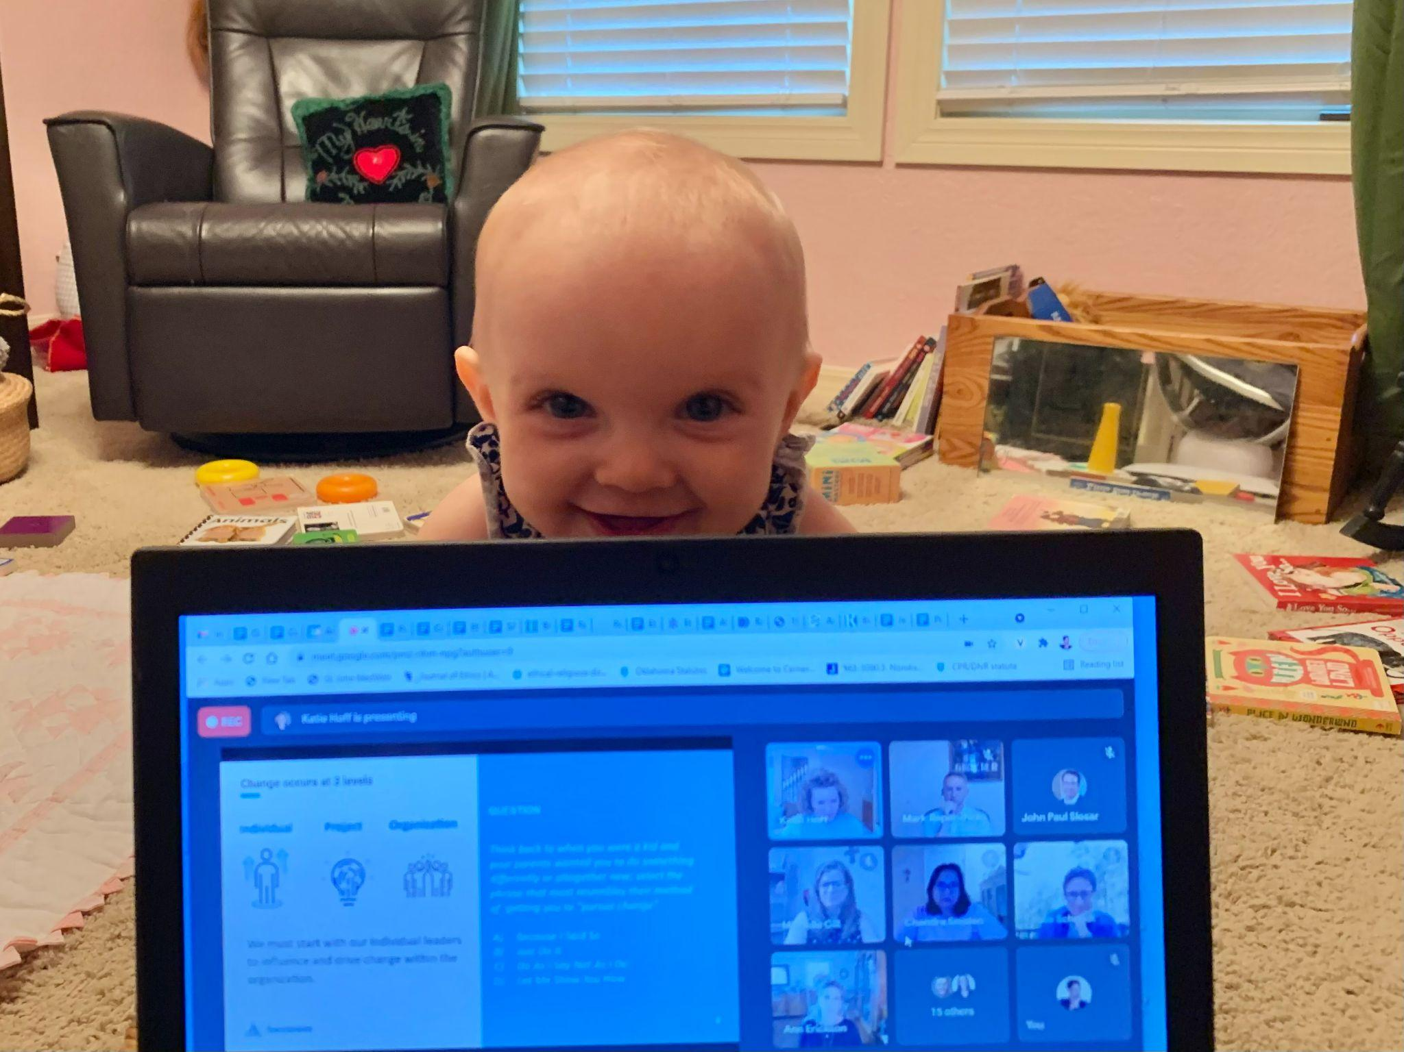
Thank You!
The 2021 Liebendorfer Virtual Ethics Symposium would not have been possible without the support of the following people:
LaQuita Jones
Whitney Dockrey
The EIC Education Subcommittee
Angelica Williams and Morgan Hargrove
The Ascension EAC
Christopher Kidd
Matthew C. Hesse
Honor Ullrich helps her mother ‘work’ from home

Slide 27
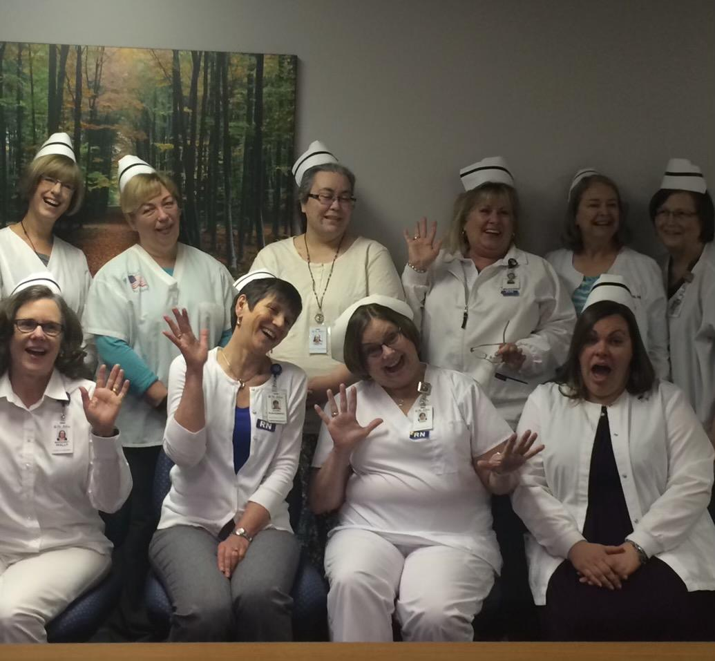
Interprofessional Continuing Education credit
Thank you for your participation!
We are happy to provide 3.00 Interprofessional Continuing Education credits for learning and change for your participation in today’s presentation of 2021 Richard Liebendorfer, MD Ethics Symposium: Women’s Health Is Human Health.
If you are having difficulty, sign in to https://ascension-ce-cme.cloud-cme.com with your Ascension Single Sign On and update your profile. If you do not have an Ascension SSO, you can create an account with an external email address.
Then text the the information again.
The Quality Department celebrates Nurses Day

Slide 28
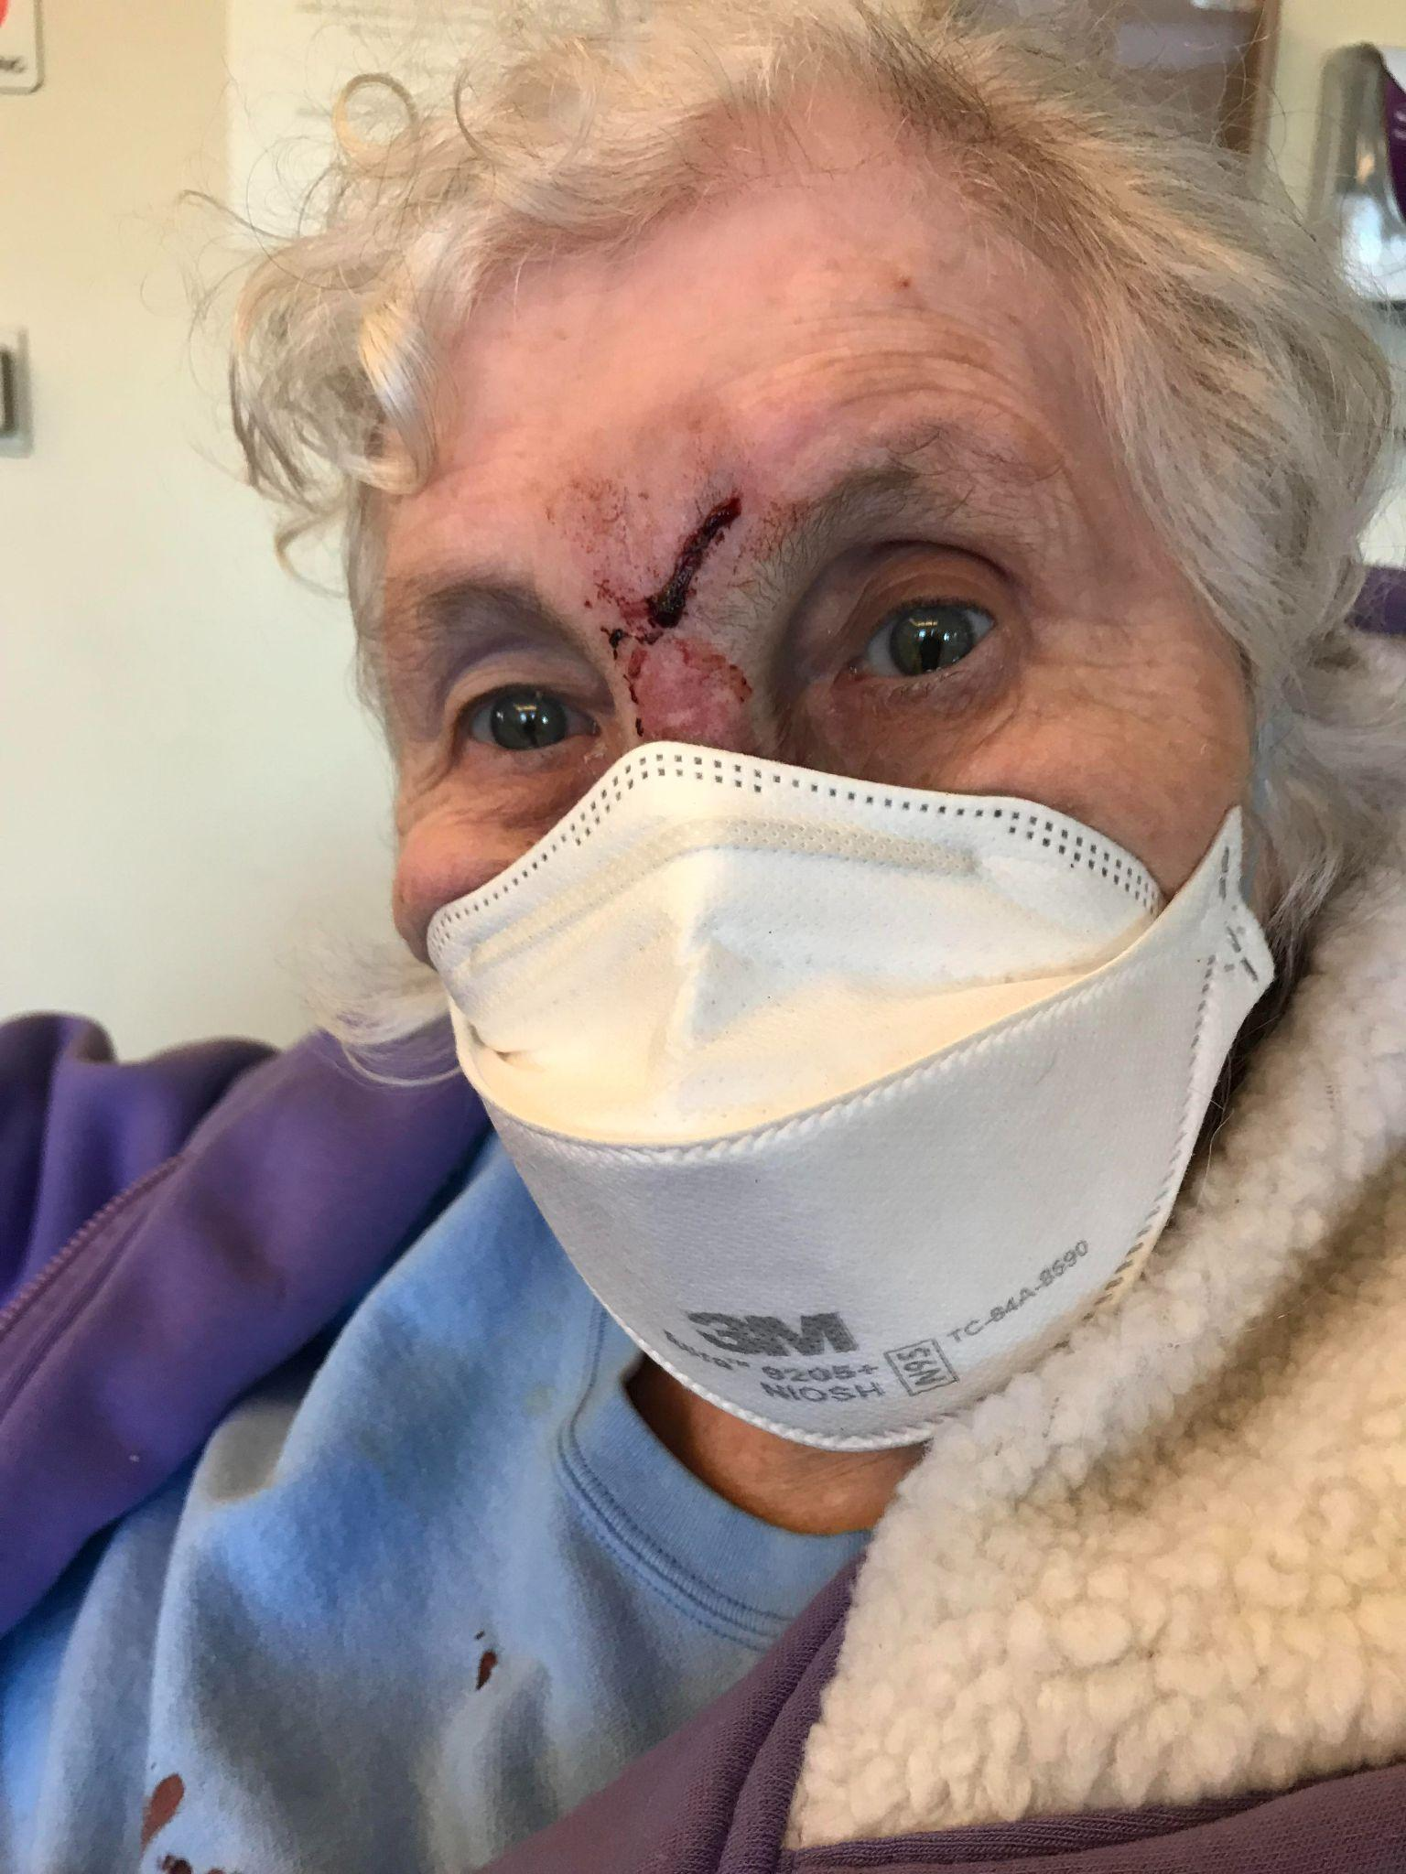
Dana Langbein’s 90 year-old mother looks pensive as she waits for treatment in an ED waiting room

